Slide 1
Natural Language Processing-Part 2
Marziyeh Mousavi
Introduction to datascience
Fall 2024

Slide 2
Topic Modeling
Topic modeling is a frequently used approach to discover hidden semantic patterns portrayed by a text corpus and automatically identify topics that exist inside it.
Namely, it’s a type of statistical modeling that leverages unsupervised machine learning to analyze and identify clusters or groups of similar words within a body of text.
For example, a topic modeling algorithm may be deployed to determine whether the contents of a document imply it’s an invoice, complaint, or contract.

Slide 3
Topic Modeling
Topics are the latent descriptions of a corpus (large group) of text. Intuitively, documents regarding a specific topic are more likely to produce certain words more frequently.
For example, the words “dog” and “bone” are more likely to appear in documents concerning dogs, whereas “cat” and “meow” are more likely to be found in documents regarding cats. Consequently, the topic model would scan the documents and produce clusters of similar words.
Essentially, topic models work by deducing words and grouping similar ones into topics to create topic clusters

Slide 4
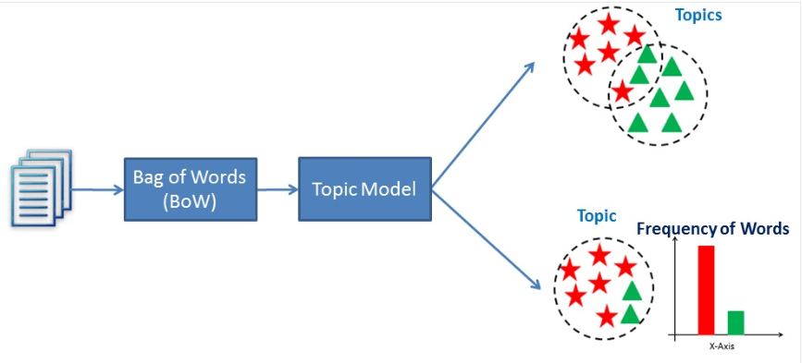
Topic Modeling
A visualization of how topic modeling works

Slide 5
Topic Modeling
A visualization of how topic modeling works

Slide 6
Topic Modeling Techniques
Two popular topic modeling techniques are Latent Semantic Analysis (LSA) and Latent Dirichlet Allocation (LDA). Their objective to discover hidden semantic patterns portrayed by text data is the same, but how they achieve it is different.

Slide 7
Topic Modeling Techniques-LSA
Namely, LSA assumes words with similar meanings will appear in similar documents. It does so by constructing a matrix containing the word counts per document, where each row represents a unique word, and columns represent each document, and then using a Singular Value Decomposition (SVD) to reduce the number of rows while preserving the similarity structure among columns. SVD is a mathematical method that simplifies data while keeping its important features. It's used here to maintain the relationships between words and documents.

Slide 8
Topic Modeling Techniques-LSA
To determine the similarity between documents, cosine similarity is used. This is a measure that calculates the cosine of the angle between two vectors, in this case, representing documents. A value close to 1 means the documents are very similar based on the words in them, whereas a value close to 0 means they're quite different.

Slide 9
Topic Modeling Techniques-LDA
LDA is a Bayesian network, meaning it’s a generative statistical model that assumes documents are made up of words that aid in determining the topics. Thus, documents are mapped to a list of topics by assigning each word in the document to different topics. This model ignores the order of words occurring in a document and treats them as a bag of words.

Slide 10
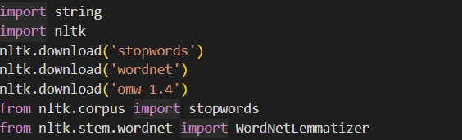
Implementation in python
First we do some imports and downloads

Slide 11

Implementation in python
This our corpus:
doc6="Some computer systems use a multistage boot process: When the computer is first powered on, a small boot loader located in nonvolatile firmware known as BIOS is run. This initial boot loader usually does nothing more than load a second boot loader, which is located at a fixed disk location called the boot block. The program stored in the boot block may be sophisticated enough to load the entire operating system into memory and begin its execution.“

Slide 12
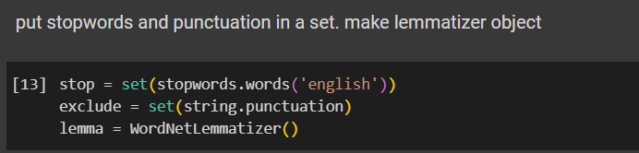
Implementation in python
First we do some preprocessing

Slide 13
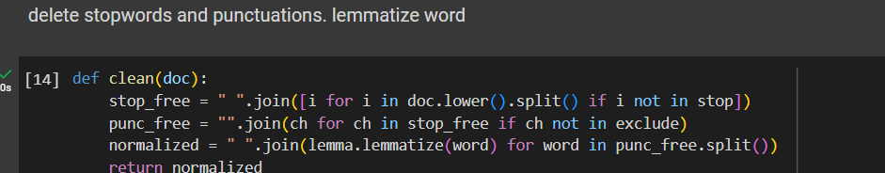
Implementation in python
First we do some preprocessing

Slide 14
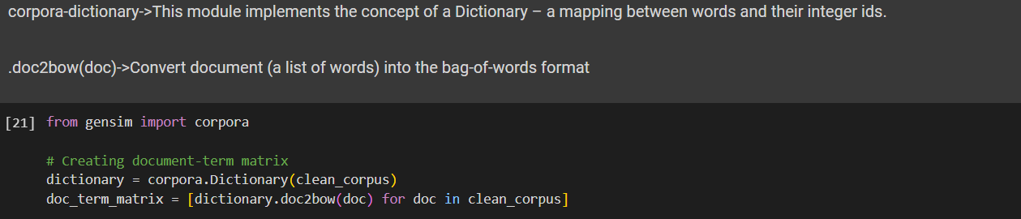
Implementation in python
Before we can use this data as input to a LDA or LSA model, it must be converted to a term-document matrix. A term-document matrix is merely a mathematical representation of a set of documents and the terms contained within them.
It’s created by counting the occurrence of every term in each document and then normalizing the counts to create a matrix of values that can be used for analysis.

Slide 15
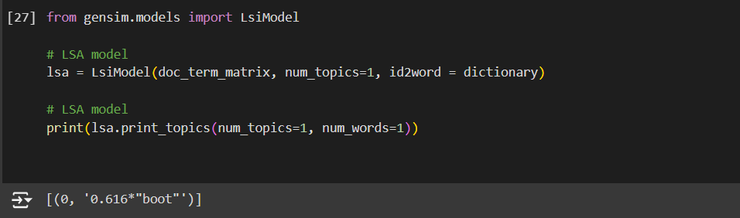
Implementation in python
Then we fit our model:

Slide 16
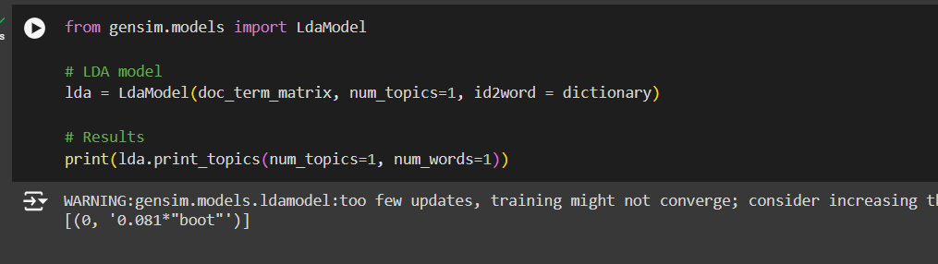
Implementation in python
Then we fit our model:

Slide 17
Word vectors
Word embeddings (also called word vectors) represent each word numerically in such a way that the vector corresponds to how that word is used or what it means. Vector encodings are learned by considering the context in which the words appear. Words that appear in similar contexts will have similar vectors. For example, vectors for "leopard", "lion", and "tiger" will be close together, while they'll be far away from "planet" and "castle

Slide 18
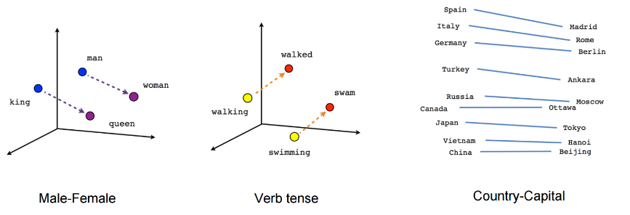
Word vectors
Even cooler, relations between words can be examined with mathematical operations. Subtracting the vectors for "man" and "woman" will return another vector. If you add that to the vector for "king" the result is close to the vector for "queen”.

Slide 19
Word vectors
These vectors can be used as features for machine learning models. Word vectors will typically improve the performance of your models above bag of words encoding. spaCy provides embeddings learned from a model called Word2Vec. You can access them by loading a large language model like en_core_web_lg. Then they will be available on tokens from the .vector attribute

Slide 20
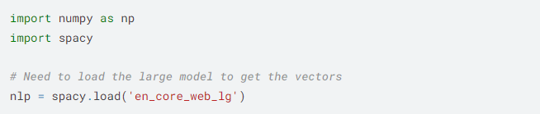
Implementation in python
First we load spacy (a library for nlp) and numpy.
There are many models of spacy. We load en_core_web_lg as we said before.

Slide 21
Implementation in python
First we load spacy (a library for nlp) and numpy.
There are many models of spacy. We load en_core_web_lg as we said before.

Slide 22
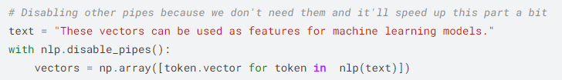
Implementation in python
Using nlp we tokenize the text and we see the word vector for each
If we see the dimensions of vector we have:
(5572, 300)

Slide 23
Implementation in python
These are 300-dimensional vectors, with one vector for each word. However, we only have document-level labels and our models won't be able to use the word-level embeddings. So, you need a vector representation for the entire document.
There are many ways to combine all the word vectors into a single document vector we can use for model training. A simple and surprisingly effective approach is simply averaging the vectors for each word in the document. Then, you can use these document vectors for modeling.

